Slide 1
Case Study Presentation
Emiliano Tan
GOTyme – Data Scientist Application

Slide 2
Background
We are a group of data scientists providing support to companies and businesses in their model development.
Objective
We are tasked to create a model to classify whether a customer will take up a sales offer after taking a cold call.
We are tasked to overlay the revenue / cost impacts based on our classification model.

Slide 3
Part 1: Model Development

Slide 4
Methodology
Load the dataset
Split the numerical and categorical data
Remove empty rows
Feature Engineering
Drop features which offer no information gain
Replace row values that are very low in frequency
Perform mapping / one-hot-encoding
Split dataset to train and test set (stratify)
Model creation
Model selection
Review feature importance

Slide 5
Feature Engineering
Variable | Type | Description
Feature_ae_0 | Numeric | Customer - Age of the customer
Feature_dn_1 | Numeric | Telematics - Latest call duration (in seconds), measured during last sales call
Feature_cn_2 | Numeric | Telematics - Number of call attempts made to the customer
Feature_ps_3 | Numeric | Telematics - Number of days which passed since the last campaign
Feature_ps_4 | Numeric | Telematics - Number of call attempts made to the customer for the previous campaign
Feature_ee_5 | Numeric | Macro variable - employment variation rate (Quarterly)
Feature_cx_6 | Numeric | Macro variable - consumer price index (Monthly)
Feature_cx_7 | Numeric | Macro variable - consumer confidence index (Monthly)
Feature_em_8 | Numeric | Macro variable - 3 month interbank rate (Quarterly)
Feature_nd_9 | Numeric | Macro variable - number of employees (Quarterly)
Feature_jd_10 | Category | Customer - type of employment
Feature_md_11 | Category | Customer - civil status
Feature_ed_12 | Category | Customer - highest level of education
Feature_dd_13 | Category | Customer - has some type of credit faclity in default
Feature_hd_14 | Category | Customer - has a home loan
Feature_ld_15 | Category | Customer - has a personal loan
Feature_cd_16 | Category | Customer - contact medium
Feature_md_17 | Category | Telematics - month when last contacted
Feature_dd_18 | Category | Telematics - day of the week when last contacted
Feature_pd_19 | Category | Performance - outcome of the previous campaign
Response | Binary | Did the customer take up the offer 1 = Yes, 0 = No
Target

Slide 6
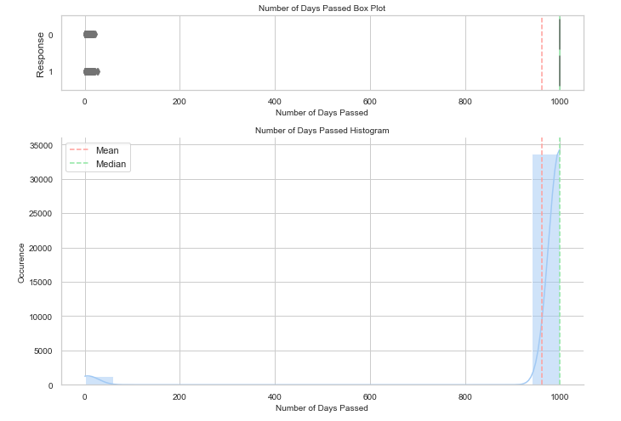
Feature Engineering
Variable | Type | Description
Feature_ae_0 | Numeric | Customer - Age of the customer
Feature_dn_1 | Numeric | Telematics - Latest call duration (in seconds), measured during last sales call
Feature_cn_2 | Numeric | Telematics - Number of call attempts made to the customer
Feature_ps_3 | Numeric | Telematics - Number of days which passed since the last campaign
Feature_ps_4 | Numeric | Telematics - Number of call attempts made to the customer for the previous campaign
Feature_ee_5 | Numeric | Macro variable - employment variation rate (Quarterly)
Feature_cx_6 | Numeric | Macro variable - consumer price index (Monthly)
Feature_cx_7 | Numeric | Macro variable - consumer confidence index (Monthly)
Feature_em_8 | Numeric | Macro variable - 3 month interbank rate (Quarterly)
Feature_nd_9 | Numeric | Macro variable - number of employees (Quarterly)
Feature_jd_10 | Category | Customer - type of employment
Feature_md_11 | Category | Customer - civil status
Feature_ed_12 | Category | Customer - highest level of education
Feature_dd_13 | Category | Customer - has some type of credit faclity in default
Feature_hd_14 | Category | Customer - has a home loan
Feature_ld_15 | Category | Customer - has a personal loan
Feature_cd_16 | Category | Customer - contact medium
Feature_md_17 | Category | Telematics - month when last contacted
Feature_dd_18 | Category | Telematics - day of the week when last contacted
Feature_pd_19 | Category | Performance - outcome of the previous campaign
Response | Binary | Did the customer take up the offer 1 = Yes, 0 = No
No Information Gain

Slide 7
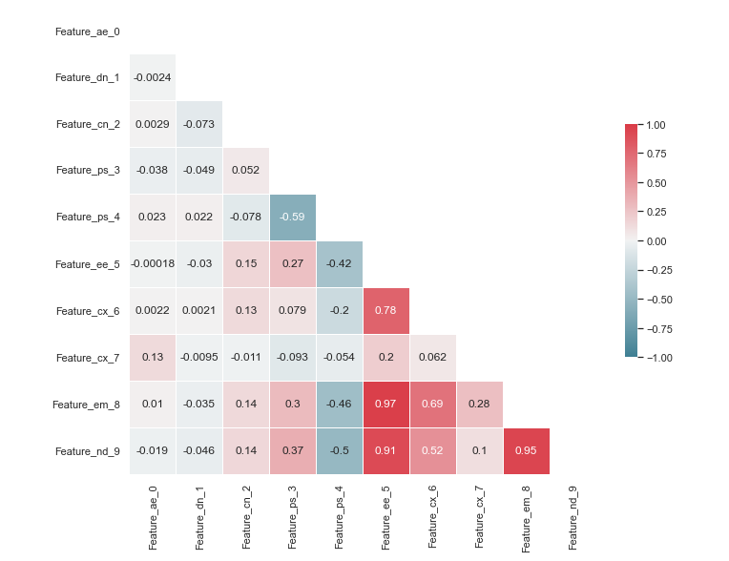
Feature Engineering
Variable | Type | Description
Feature_ae_0 | Numeric | Customer - Age of the customer
Feature_dn_1 | Numeric | Telematics - Latest call duration (in seconds), measured during last sales call
Feature_cn_2 | Numeric | Telematics - Number of call attempts made to the customer
Feature_ps_3 | Numeric | Telematics - Number of days which passed since the last campaign
Feature_ps_4 | Numeric | Telematics - Number of call attempts made to the customer for the previous campaign
Feature_ee_5 | Numeric | Macro variable - employment variation rate (Quarterly)
Feature_cx_6 | Numeric | Macro variable - consumer price index (Monthly)
Feature_cx_7 | Numeric | Macro variable - consumer confidence index (Monthly)
Feature_em_8 | Numeric | Macro variable - 3 month interbank rate (Quarterly)
Feature_nd_9 | Numeric | Macro variable - number of employees (Quarterly)
Feature_jd_10 | Category | Customer - type of employment
Feature_md_11 | Category | Customer - civil status
Feature_ed_12 | Category | Customer - highest level of education
Feature_dd_13 | Category | Customer - has some type of credit faclity in default
Feature_hd_14 | Category | Customer - has a home loan
Feature_ld_15 | Category | Customer - has a personal loan
Feature_cd_16 | Category | Customer - contact medium
Feature_md_17 | Category | Telematics - month when last contacted
Feature_dd_18 | Category | Telematics - day of the week when last contacted
Feature_pd_19 | Category | Performance - outcome of the previous campaign
Response | Binary | Did the customer take up the offer 1 = Yes, 0 = No
Highly Correlated

Slide 8
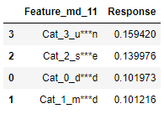
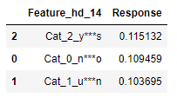
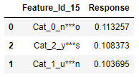
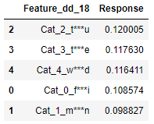
Feature Engineering
Variable | Type | Description
Feature_ae_0 | Numeric | Customer - Age of the customer
Feature_dn_1 | Numeric | Telematics - Latest call duration (in seconds), measured during last sales call
Feature_cn_2 | Numeric | Telematics - Number of call attempts made to the customer
Feature_ps_3 | Numeric | Telematics - Number of days which passed since the last campaign
Feature_ps_4 | Numeric | Telematics - Number of call attempts made to the customer for the previous campaign
Feature_ee_5 | Numeric | Macro variable - employment variation rate (Quarterly)
Feature_cx_6 | Numeric | Macro variable - consumer price index (Monthly)
Feature_cx_7 | Numeric | Macro variable - consumer confidence index (Monthly)
Feature_em_8 | Numeric | Macro variable - 3 month interbank rate (Quarterly)
Feature_nd_9 | Numeric | Macro variable - number of employees (Quarterly)
Feature_jd_10 | Category | Customer - type of employment
Feature_md_11 | Category | Customer - civil status
Feature_ed_12 | Category | Customer - highest level of education
Feature_dd_13 | Category | Customer - has some type of credit faclity in default
Feature_hd_14 | Category | Customer - has a home loan
Feature_ld_15 | Category | Customer - has a personal loan
Feature_cd_16 | Category | Customer - contact medium
Feature_md_17 | Category | Telematics - month when last contacted
Feature_dd_18 | Category | Telematics - day of the week when last contacted
Feature_pd_19 | Category | Performance - outcome of the previous campaign
Response | Binary | Did the customer take up the offer 1 = Yes, 0 = No
No Information Gain

Slide 9
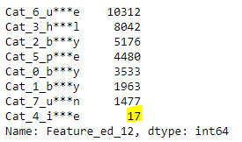

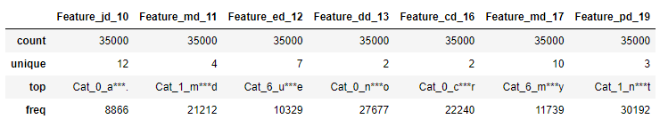
Feature Engineering
Drop features which offer no information gain
Replace row values (with mode) that are very low in frequency
Perform Mapping / One-Hot-Encoding
Variable | Type | Description
Feature_ps_3 | Numeric | Telematics - Number of days which passed since the last campaign
Feature_cx_6 | Numeric | Macro variable - consumer price index (Monthly)
Feature_em_8 | Numeric | Macro variable - 3 month interbank rate (Quarterly)
Feature_nd_9 | Numeric | Macro variable - number of employees (Quarterly)
Feature_md_11 | Category | Customer - civil status
Feature_hd_14 | Category | Customer - has a home loan
Feature_ld_15 | Category | Customer - has a personal loan
Feature_dd_18 | Category | Telematics - day of the week when last contacted

Slide 10
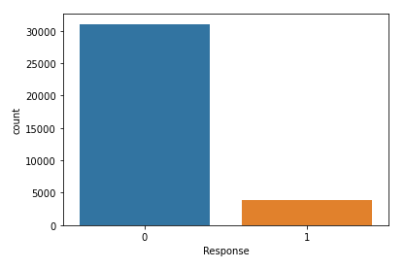
Generate Train/Test Set
Split the dataset and stratify to ensure that ‘Response’ is represented equally in the train and test sets
Model Creation
Logistic Regression
KNN
SVC
Decision Tree
Random Forest
XGBoost
If time permits, it is recommended to do hyperparameter tuning

Slide 11
Model Selection
Summary of Results
Based on the analysis, we can select the Random Forest Classifier as our model since it has the highest accuracy, and weighted f1 score.
Model | Accuracy | Test Accuracy | Weighted F1 Score
LogReg | 0.909 | 0.91 | 0.89981
KNN | 0.911 | 0.903 | 0.88442
SVM | 0.867 | 0.871 | 0.86993
Tree | 1.0 | 0.885 | 0.88565
RFC | 1.0 | 0.912 | 0.9093
XGB | 0.956 | 0.91 | 0.90701

Slide 12
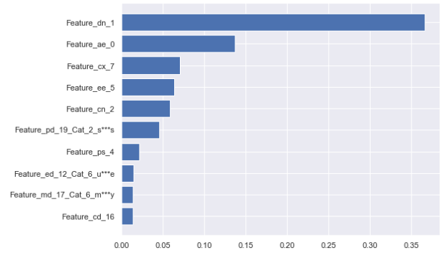
Most Important Feature
Get importance using feature_importances_ method

Slide 13
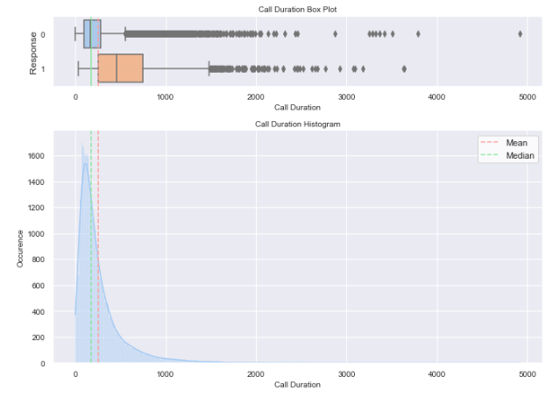
Most Important Feature
Notice that the rejected responses usually fall on calls within 100-250 seconds, while the accepted responses usually fall on calls within 250-750 seconds.
Hence, if we want to increase the positive response from customers, we must structure our calls such that it will last by 250 to 750 seconds or 4 to 12 minutes.

Slide 14
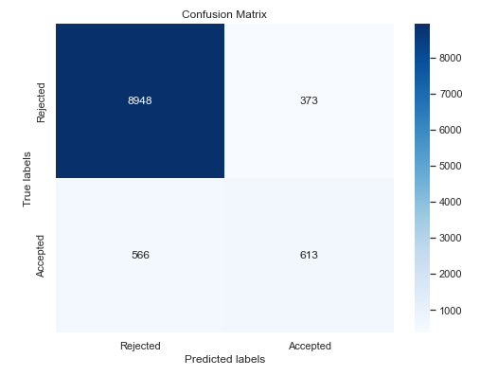
Confusion Matrix
True Positive Rate (Recall/Sensitivity)
TPR = TP/(TP+FN)
True Negative Rate (Specificity)
TNR = TN/(TN+FP)
Positive Predictive Value (Precision)
PPV = TP/(TP+FP)
Negative Predictive Value
NPV = TN/(TN+FN)
TN
FP
FN
TP

Slide 15
Part 2: Analyzing Revenue Impacts

Slide 16
Computing Potential Profit
Risk and Profit Estimate
E[Profit] = Weighted Average of Profits
If Accepted:
E[Profit-Accepted] = 10% (285) + 25% (705) + 65% (1225) = 1001
E[Profit-Rejected] = 10% (-300) + 25% (-300) + 65% (-300) = -300
 | Risk Distribution | Profit (Accepted) | Profit (Rejected)
High | 10% | 285 | -300
Medium | 25% | 705 | -300
Low | 65% | 1225 | -300

Slide 17
Computing Potential Profit (using Model)
As the business owner, you will call only those who are predicted to accept the offer.
Based on Model (Total = 10,500):
Predicted Accepted = 986 (TP = 613, FP = 373)
From the 10,000 records, the number of predicted customer who will accept the offer is:
Predict to accept = (986/10500) * 10000 = 939.05
True Positive (Will actually accept) = (613/10500) * 10000 = 583.81
False Positive (Turns out to reject) = (373/10500) * 10000 = 355.24
E[Predicted-Profit] = E[Profit-Accepted] * True Positive + E[Profit-Rejected] * False Positive
= (1001)*(583.81) + (-300)*(355.24) = 477,821.81

Slide 18
Computing Potential Profit
If we were able to correctly classify the Customers (Total = 35,000):
True Accepted = 3930
From the 10,000 records, the number of predicted customer who will accept the offer is:
True Accepted = (3930/35000) * 10000 = 1122.86
E[Predicted-Profit-Ideal] = E[Profit-Accepted] * (True Positive + False Negative)
= E[Profit-Accepted] * (True Accepted)
= (1001)*(1122.86) = 1,123,982.86

Slide 19
Lost Opportunity
The lost opportunity on potential profit can be solved by subtracting the ideal net profit by the net profit with misclassification:
Loss = E[Predicted-Profit-Ideal] - E[Predicted-Profit]
= 1,123,982.86 - 477,821.81 = 646,161.05

Slide 20
Justification of Using The Model
If the model is used until 10,000 customers were actually identified:
E[Predicted-Profit] = 477,821.81 * (10000/ 939.05) = +5,088,353.23
From the data, out of 35,000 customers, 31070 rejected and 3930 accepted
If all 10000 were called:
Total Accepted = (3930/35000) * 10000 = 1122.86
Total Rejected = (31070/35000) * 10000 = 8877.14
Without using the model
E[Predicted-Profit] = E[Profit-Accepted] * Total Accepted+ E[Profit-Rejected] * Total Rejected
= (1001)*(1122.86) + (-300)*(8877.14)
= -2,550,169.14

Slide 21
Justification of Using The Model
Not only that using the model saves the business time in calling potential customers, it will also save money by properly selecting the potential customers.
Profit using the model – Profit without using the model
= (+5,088,353.23) – (-2,550,169.14)
= +7,638,522.37
Conclusion:
The model for predicting the customer response based on cold calls will deliver a positive impact in improving the sales campaign of the business. Using the model converts a negative profitability into a potential 300% gain.

